Slide 1
INDIA'S GDP
UNDER LOCKDOWN
Data readout · 28 states · 10 sectors · 2019–2022
Analysis of the "India GDP Loss During COVID-19" dataset, Kaggle
Notes:
One dataset, one question: how deep did it go, and how far back have we come?

Slide 2
2,500 RECORDS, ZERO MISSING VALUES
Fields
GDP, jobs, vaccines
Quality
Coverage
No nulls
28 × 10
Before/during GDP, unemployment, vaccination, lockdown severity, migration, health index, recovery.
No duplicates. Government support flat across every record.
States and sectors, 2019–2022.
02
Notes:
Clean dataset. One flag already: support is a constant, not a variable.

Slide 3
NO STATE, NO SECTOR WAS SPARED
0
28 / 28
10 / 10
Records with no GDP loss
States that contracted
Sectors that contracted
India GDP Loss During COVID-19, 2,500 state-sector records.
03
Notes:
There is no control group in this dataset. Everything contracted.

Slide 4
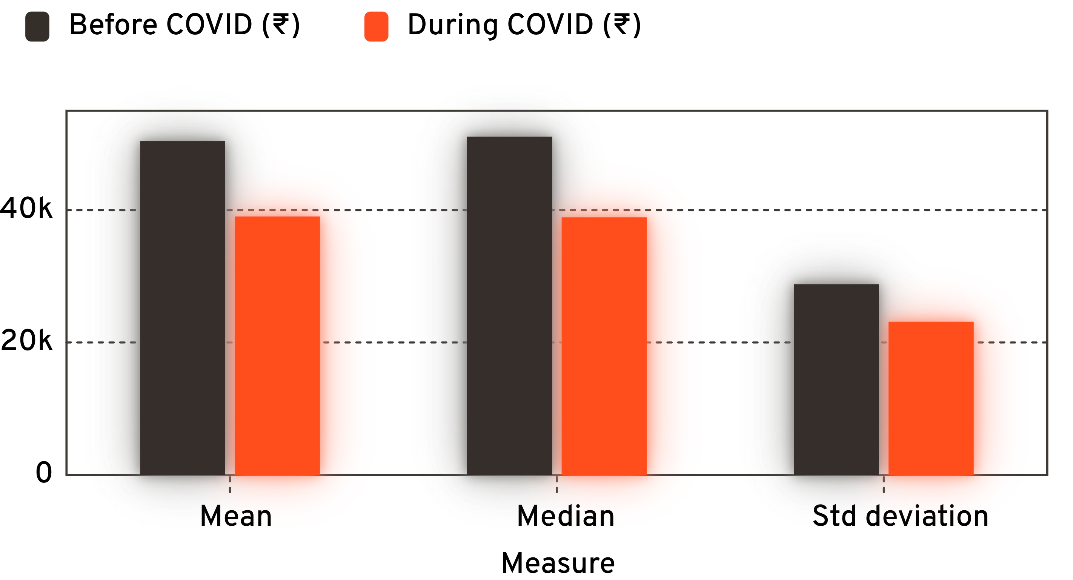
RICH AND POOR STATES DIVERGED
AVERAGE GDP FELL 22.7%
Standard deviation narrowed, ₹28,798 → ₹23,136. The coefficient of variation rose anyway.
cv = (std/mean)*100
cv_1 = 57.25%
cv_2 = 59.34%
A Shopkeeper earning 1000 looses 500 vs Businessman earning 10 lakhs loosing 10,000
Mean ₹50,388.95 → ₹39,027.99. Median ₹51,081 → ₹38,908, a 23.6% decline.
04
Notes:
Spread got smaller in rupees, bigger in proportion. That gap is the story of the rest of the deck.

Slide 5
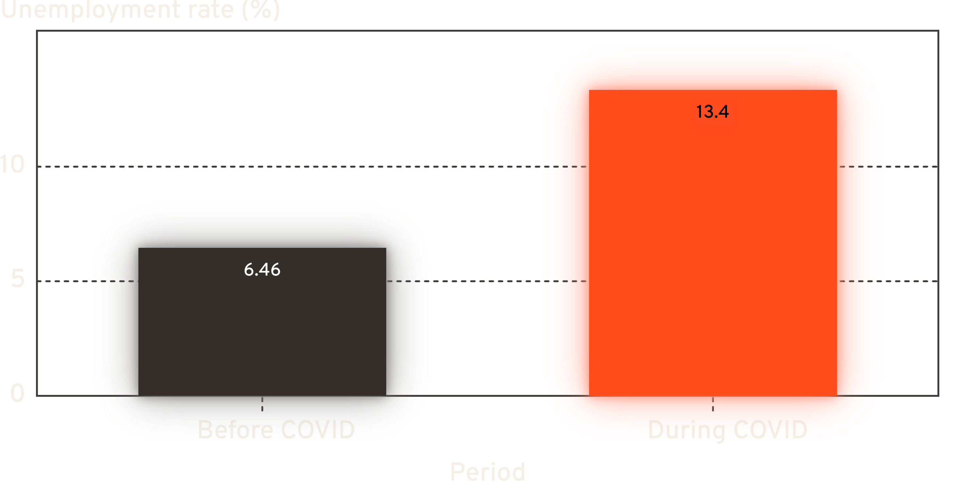
UNEMPLOYMENT NEARLY DOUBLED
+107.9%
Increase in unemployment, before COVID to during
During-COVID rates ranged 5.25%–21.66% across records. Smaller states hit harder; metro-adjacent regions fared better.
05
Notes:
6.46 to 13.35. The range matters as much as the mean — 5.25 at best, 21.66 at worst.

Slide 6
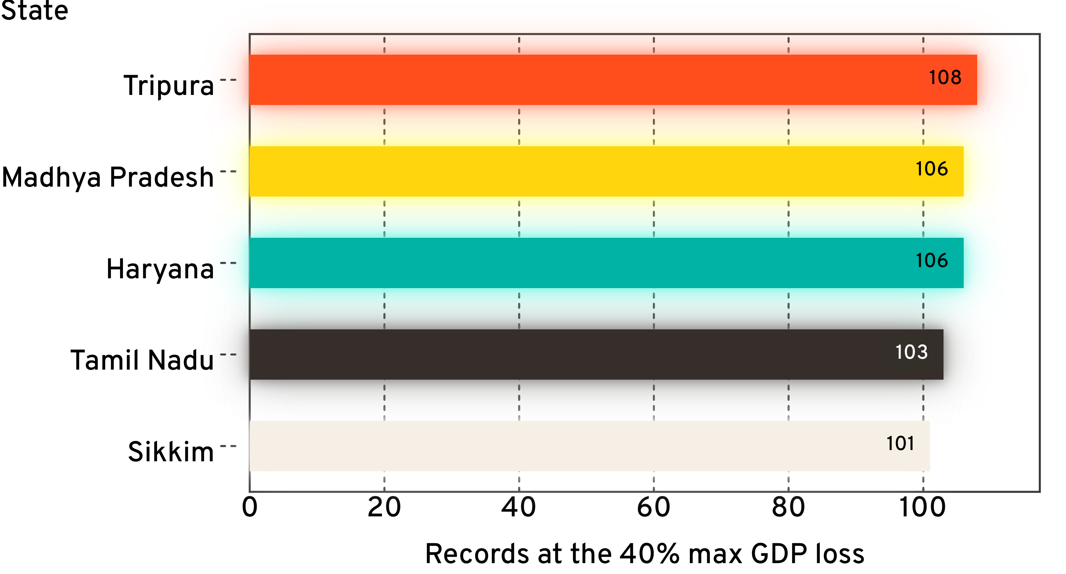
TRIPURA RECORDED THE DEEPEST LOSSES, MOST OFTEN
108 RECORDS AT THE CEILING
Highest of any state. Madhya Pradesh and Haryana follow closely at 106 each.
Count of records hitting the 40% maximum GDP loss.
06
Notes:
Frequency, not depth — 40% is the cap, and Tripura reaches it more often than anyone.

Slide 7
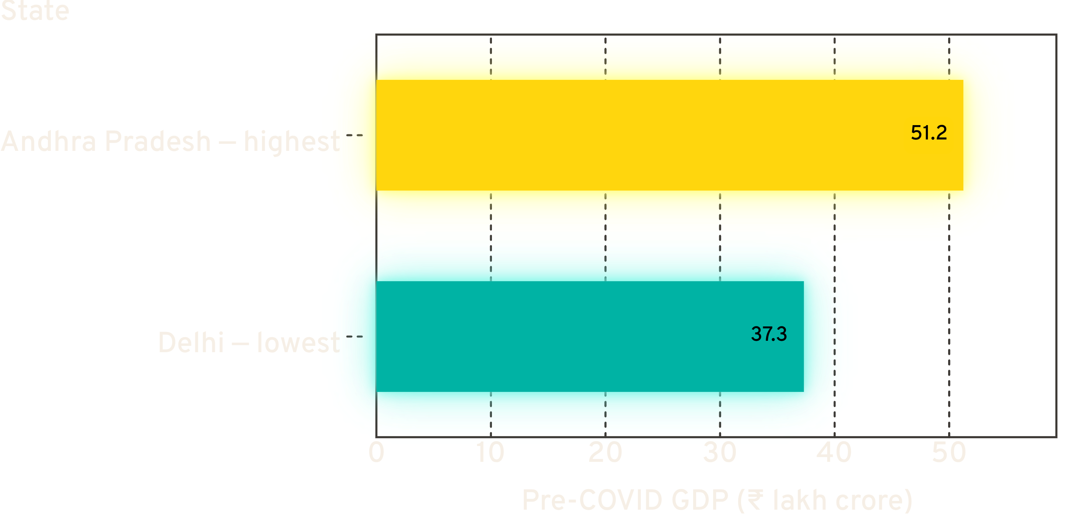
BIGGER ECONOMIES SHOW THE WIDEST ABSOLUTE DROP
THE ORDER HELD
Relative ranking between states stayed largely consistent through the crisis.
Pre-COVID GDP, highest and lowest states in the dataset.
07
Notes:
The shock was broad, not re-ordering. Who was ahead stayed ahead.

Slide 8
MANUFACTURING AND TRANSPORT WERE HIT HARDEST
Sector group | Impact scale, 1–10 | Where records cluster
Manufacturing | Top of scale | Hit hardest
Transport | Top of scale | Hit hardest
Essential sectors | Lower | Held up
Mining | Lowest | Held up best
28%
Of records carry a "High Impact" remark
08
Notes:
Close on the sector split: movement-dependent sectors took the damage; extraction and essentials absorbed it.

Slide 9
VACCINATION RATE
A critical driver of recovery trajectory.
02
LOCKDOWN SEVERITY
THE RECOVERY
LEVERS
Directly correlated with the size of GDP loss.
MIGRATION EFFECT
Significant labor-force redistribution after COVID.
GOVERNMENT SUPPORT
A flat ₹797.03 across every state and sector — uniform, not targeted.
Notes:
Three levers moved. The fourth was a constant — the same rupee figure everywhere, regardless of damage.

Slide 10
RECOVERY SITS AT 55%, SIX YEARS ON
55%
62%
52%
RECOVERY PROGRESS
HEALTH INDEX
VACCINATION RATE
55.10% across records.
61.95.
51.55%.
Inflation rate 5.95%. Most state-sector pairs remain short of a full rebound.
10
Notes:
Halfway back. Not recovered — recovering.

Slide 11
11

